Slide 1
SIFT Training
Training Objectives
SIFT Extract Documentation and how it can be used to assist Providers in SIFT Usage
Specific SIFT Tables to be used to manage Program Productivity
Identification of Specific SIFT Tables and Queries that can be used to manage Claim Processing

Slide 2
Agenda
Documentation
Claim Data Flow
Claim Submission Calendar
DMH Payment Report
SIFT Folder Structure
The Working Folder
Table Link
Suggested Link Tables
HIPAA 999 Transactions
HIPAA 277 Transactions
Query Examples
Adding a Query with SQL
Additional Tables Added

Slide 3
Documentation
Documentation - Department of Mental Health
Claim Adjustment Reason Codes | X12
Remittance Advice Remark Codes | X12

Slide 4
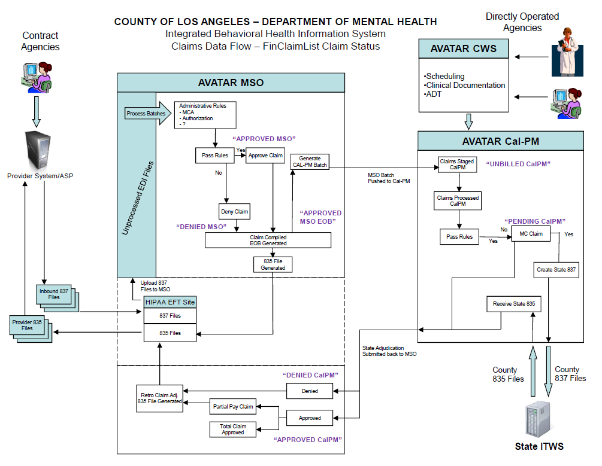
Claim Data Flow
Understanding the Claim Data Flow will allow you to troubleshoot problems and set expectations for your agency.
Denied MSO – Claim Denied for Avatar Rules
Approved MSO – Claim Accepted by Avatar Waiting for payment
Approved MSO EOB – Claim Identified for Payment
Unbilled CalPM – Claim has been paid waiting for submission to State
Pending CalPM – Claim Included on State File
Approved CalPM – Approved Claim
Denied CalPM – Denied Claim
Void/Resub – When your system sends a Void Transaction (8) or Resubmit Transaction (7) the claim status of the original claim will change to the Void/Resub value

Slide 5
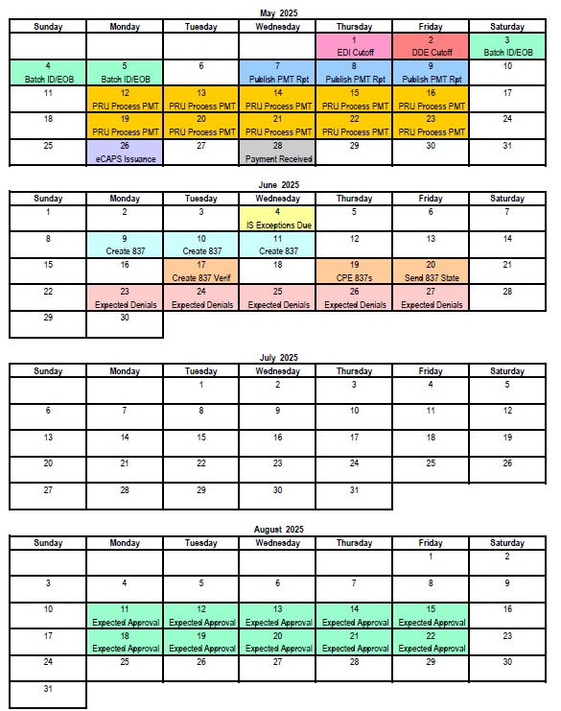
Claim Submission Calendar
The EDI Cutoff Date is key to the processing of claims.
All claims submitted between the last cutoff date that the current date will be included in the current month’s Explanation of Benefits (EOB).
Expect to see your claims shift from Approved MSO to Approved MSO EOB on your May 12th LE Extract.
A Medi-Cal Claim submitted on April 7th (after the previous cutoff date) can expect to be approved by the State toward the end of August.
Note: This Calendar is a best-case scenario.

Slide 6
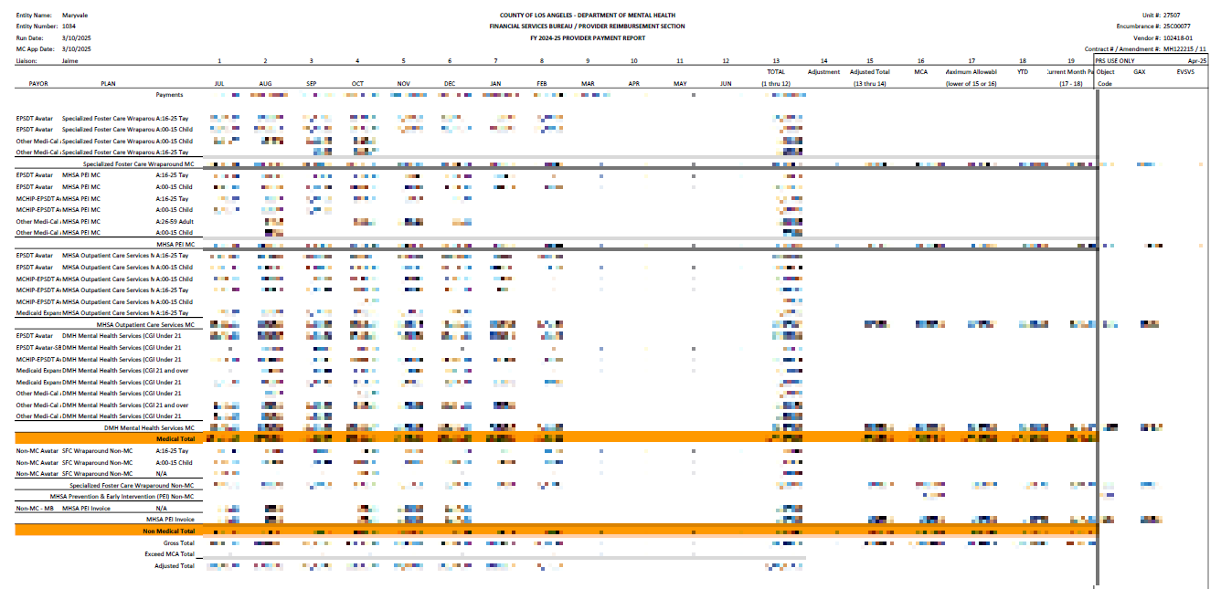
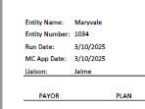
DMH Payment Report
At the top of your monthly Payment Report take note of the Run Date.
Use the following Monday’s LE Extract to verify your Payment Report.
Claim Status Used for Payment:
- Approved-MSOEOB - Unbilled-CalPM - Pending-CalPM - Approved-CalPM

Slide 7
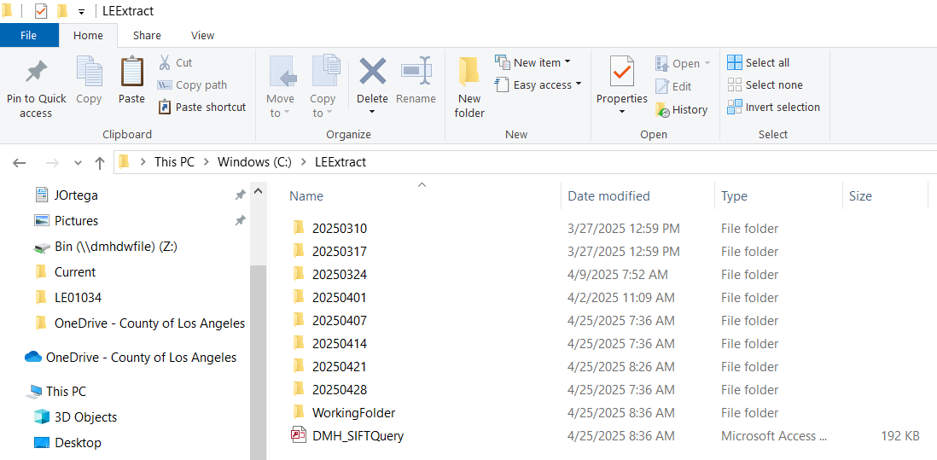
SIFT Folder Structure
DMH does not keep historical copies of your SIFT Extracts.
We suggest you create dated folders each week and keep a copy of that week’s Extract Files in these Folders.
This will allow you to develop queries with data used to develop reports you are validating.
Possible Uses:
- Payment Report Validation - Audit Data Validation - Cost Report Settlement

Slide 8
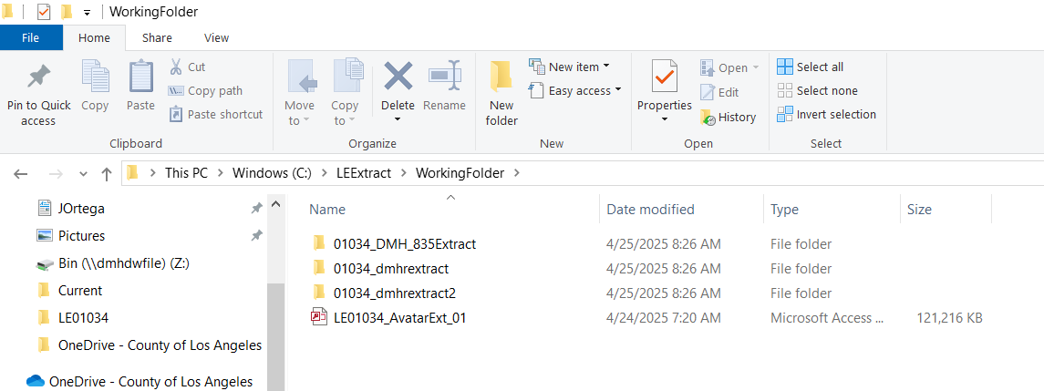
The Working Folder
The Working Folders is to be used for your current workspace.
Our suggestion is to copy the data from the dated folder which is closest to the report or audit you are verifying.
Table Links will be used to point to the tables in the Working Folder.
Existing Queries in a working Database will run with Historical Data you are analyzing.

Slide 9
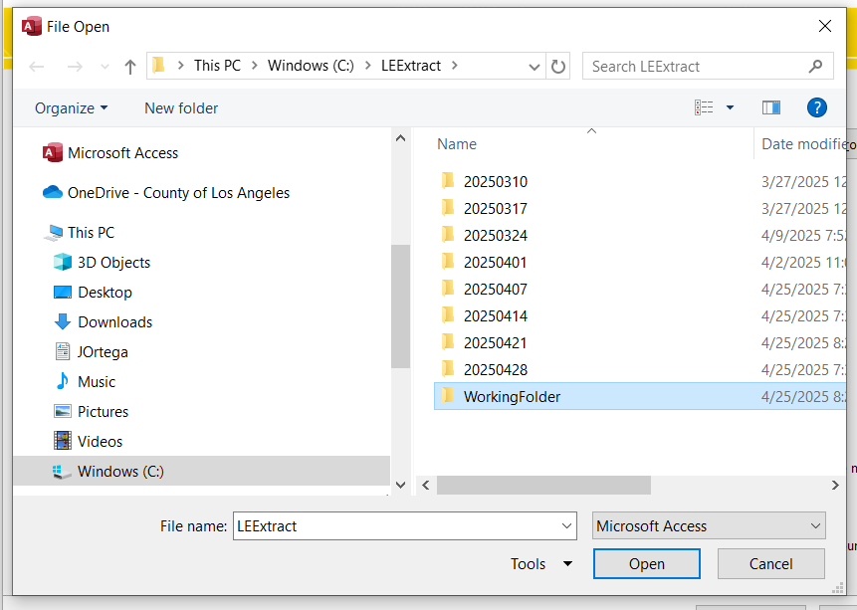
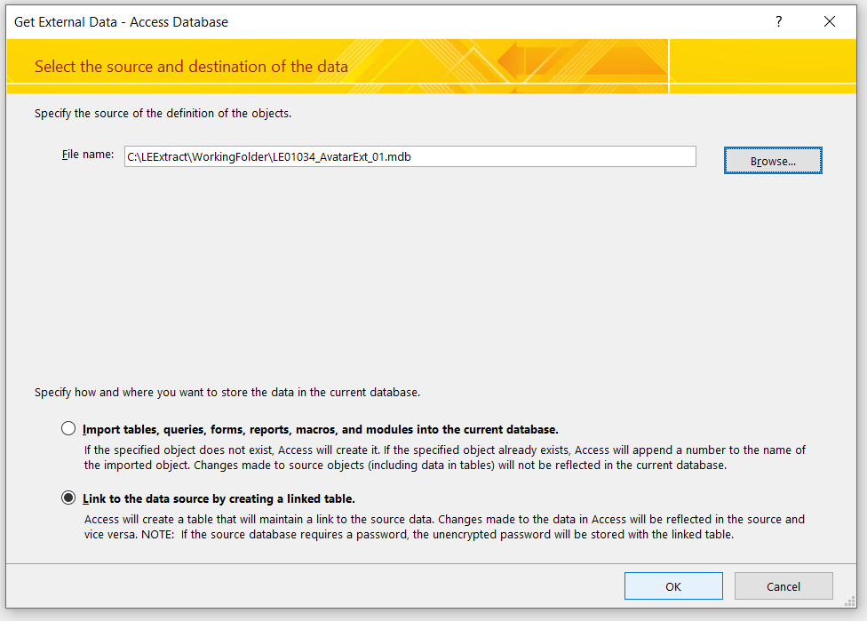
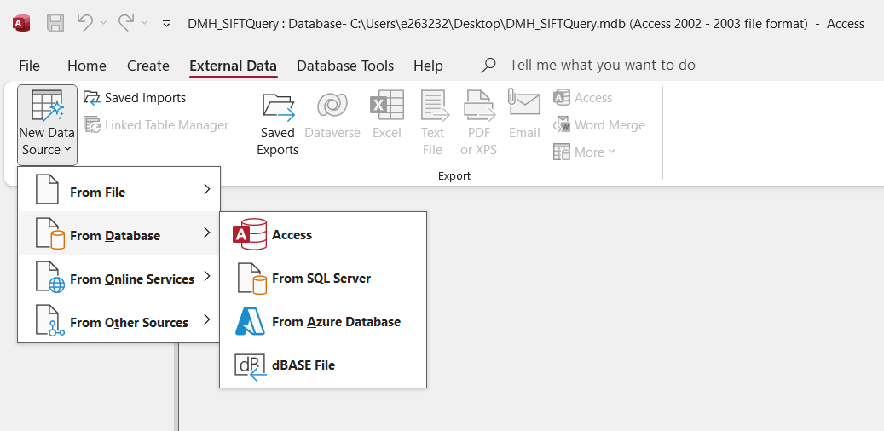
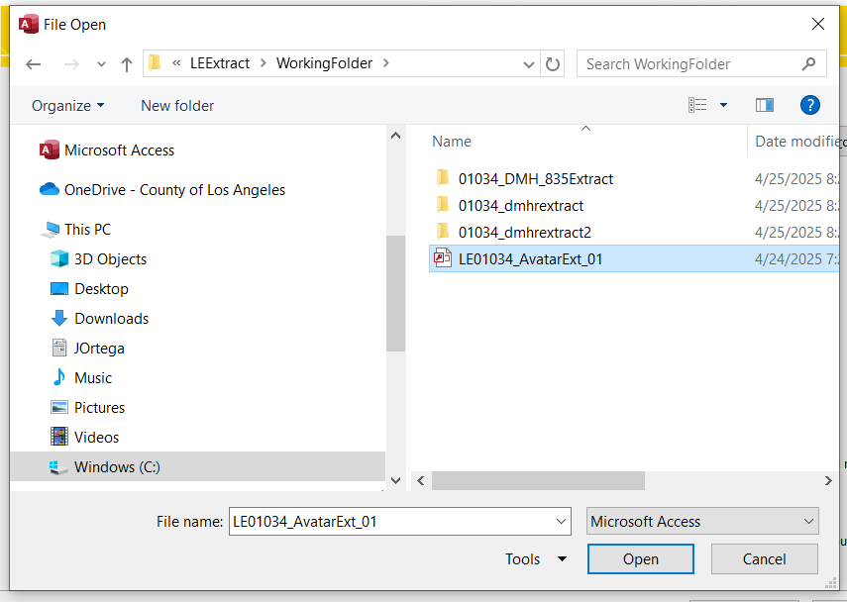
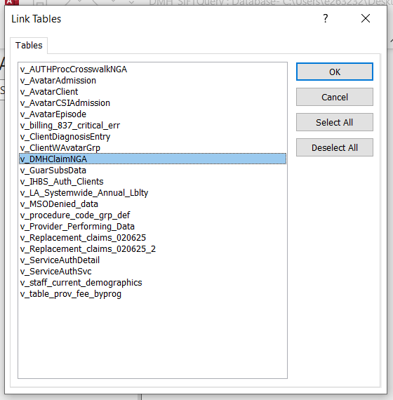
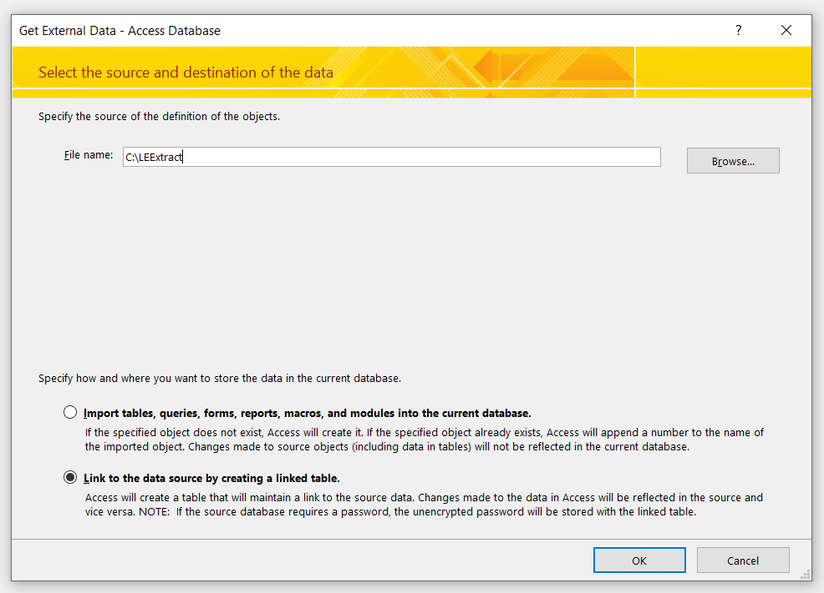
Table Link
Step 5 – Select Link to the Data Source Option then OK
Step 3 – Open your Working Folder
Step 1 – Select External Data Menu -> From Database -> Access
Step 4 – Open your Table Source
Step 6 – Select the Table you would like to Link then OK
Step 2 – Browse for the Location of your Working Folder

Slide 10
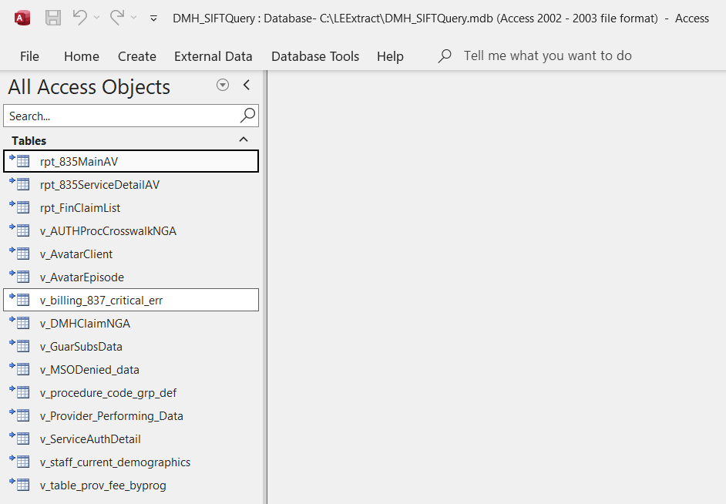
Suggested Link Tables
TABLE USAGE
rpt_835MainAV – Used to identify State Claim Status and Aid Code
rpt_835ServiceDetailAV – Used to identify State Claim deny Reason
rpt_FinClaimList – Used for Payment, Cost Reporting, Claim Status, and productivity
v_AUTHProcCrosswalkNGA – Used to identify PAuth Authorizations and their allowable Procedure Codes
v_AvatarClient – Used to verify Client Demographics
v_AvatarEpisode – Used to verify Client Episodes
v_billing_837_critical_err – Used to identify rejected claim reasons
v_DMHClaimNGA – Used to identify history of claim and status
v_GuarSubsData – Used to verify client eligibility
v_MSODenied_data – Used to identify MSO Denied Claims and reasons
v_procedure_code_grp_def – Used to identify Procedure Codes associated to a group used for rates
v_Provider_Performing_Data – Used to verify Provider MSO Data
v_ServiceAuthDetail – Used to Identify PAuth and MAuth Authorization Numbers and MCAs
v_staff_current_demographics – Used to verify Provider CalPM Data
v_table_prov_fee_byprog – Used to identify rates assigned to LE at the Program Level
LINKED TABLES A linked table is identified with the Arrow to the left of the worksheet icon next to the name of the linked table.
If the arrow is missing the table was probably imported and not linked.
Linked tables are used to develop queries from multiple locations and in our example used to develop historical context to your reports.

Slide 11
HIPAA 999 Transactions
837 FILE LINK
ISA*00* *00* *14*078315267 *14*132486189 *250416*0644*^*00501*000001505*1*P*:~
GS*HC*078315267*132486189*20250416*0644*1505*X*005010X222A1~
ST*837*0001*005010X222A1~
BHT*0019*00*1505*20250416*0644*CH~
NM1*41*2*Legal Entity Name*****46*000000000~
POSITIVE 999
ISA*00* *00* *14*132486189 *14*078315267 *250416*2142*^*00501*000001505*1*P*:~ GS*FA*132486189*078315267*20250416*2142*1505*X*005010X231A1~ ST*999*0001*005010X231A1~ AK1*HC*1505*005010X222A1~ AK2*837*0001*005010X222A1~ IK5*A~ AK9*A*1*1*1~ SE*6*0001~ GE*1*1505~ IEA*1*000001505~
Verify your 999 Files daily
Match 837 File GS06 with the 999 AK102
The AK901 will be A-Accepted or R-Rejected
NEGATIVE 999
ISA*00* *00* *14*132486189 *14*079341110 *230424*1423*!*00501*100294155*1*P*:~ GS*FA*132486189*079341110*20230424*1423*1*X*005010X231A1~ ST*999*0001*005010X231A1~ AK1*HC*1*005010X222A1~ AK2*837*100294155*005010X222A1~ IK3*REF*27**3~ CTX*SITUATIONAL TRIGGER*REF*27~ IK5*R*5~ AK9*R*1*1*0~ SE*8*0001~ GE*1*1~ IEA*1*100294155~

Slide 12
HIPAA 277 Transactions
ISA*00* *00* *14*132486189 *14*078315267 *250416*1843*^*00501*000000003*1*P*:~ GS*HN*132486189*078315267*20250416*184341*3*X*005010X214~ ST*277*0003*005010X214~ BHT*0085*08*3*20250416*184341*TH~ HL*1**20*1~ NM1*PR*2*LAC Department of Mental Health*****PI*00000001~ TRN*1*20250416184341~ DTP*050*D8*20250416~ DTP*009*D8*20250416~ HL*2*1*21*1~ NM1*41*2*MARYVALE*****46*078315267~ TRN*2*1505~ STC*A2:20*20250416*WQ*1978.98~ QTY*90*6~ AMT*YU*1978.98~ HL*3*2*19*1~ NM1*85*2*Legal Entity Name*****XX*000000000~ TRN*1*0~ STC*A2:20**WQ*1978.98~ QTY*QA*6~AMT*YU*1978.98~ HL*4*3*PT~ NM1*QC*1*xxxx*xxx****MI*MSO999999~ TRN*2*12126488600100570638~ STC*A2:20*20250416*WQ*344.17~ REF*1K*51798375~ DTP*472*D8*20250402~ HL*5*3*PT~ NM1*QC*1*xxxx*xxx****MI*MSO999999~ TRN*2*12126488600100570926~ STC*A2:20*20250416*WQ*172.09~ REF*1K*51798376~ DTP*472*D8*20250407~ HL*6*3*PT~ NM1*QC*1*xxxx*xxx****MI*MSO999999~ TRN*2*12126488600100571093~ STC*A2:20*20250416*WQ*344.17~ REF*1K*51798377~ DTP*472*D8*20250409~ HL*7*3*PT~ NM1*QC*1*xxxx*xxx****MI*MSO999999~ TRN*2*12188420520100571371~ STC*A2:20*20250416*WQ*430.21~ REF*1K*51798378~ DTP*472*D8*20250410~ HL*8*3*PT~ NM1*QC*1*xxxx*xxx****MI*MSO999999~ TRN*2*12193151680200562011~ STC*A2:20*20250416*WQ*344.17~ REF*1K*51798379~ DTP*472*D8*20241107~ HL*9*3*PT~ NM1*QC*1*xxxx*xxx****MI*MSO999999~ TRN*2*12194456440100571094~ STC*A2:20*20250416*WQ*344.17~ REF*1K*51798380~ DTP*472*D8*20250409~ SE*56*0003~ GE*1*3~ IEA*1*000000003~
Link your 277 File with the first TRN02 to your 837 GS06
The ClaimSubmittersIdentifiers (aka. Claim_Submt_ID in DMHCLaimNGA) are included in the following TRN02 segments
Your Payer Claim Control Number (PCCN) can be found in REF02. This number will appear in DMHClaimNGA after payment in the ClaimNumber_MSO Field. Your system will use this value for Voids and Resubmits.

Slide 13
Query Examples
835 Main Query: SELECT rpt_835MainAV.CLID,rpt_835MainAV.ClaimID, rpt_835MainAV.ClaimStatus, rpt_835MainAV.ApprvAidCode, rpt_835MainAV.ChargeAmt, rpt_835MainAV.ApprovedAmt, rpt_835MainAV.ProcedureCode, rpt_835MainAV.UOS, rpt_835MainAV.ServiceDate, rpt_835MainAV.ModifiedDate, rpt_835MainAV.BatchName, rpt_835MainAV.FFP, rpt_835MainAV.CIN, rpt_835MainAV.PayerClaimControlNumber, rpt_835MainAV.[837FileName] FROM rpt_835MainAV; Note: Use ClaimID to link to rpt_FinClaimList.OBClaimSubID or v_DMHClaimNGA.OB_ClaimSubID
835 Service Detail Query: SELECT rpt_835ServiceDetailAV.CLID, rpt_835ServiceDetailAV.ClaimID, rpt_835ServiceDetailAV.SvcProvider, rpt_835ServiceDetailAV.Sequence, rpt_835ServiceDetailAV.Identifier, rpt_835ServiceDetailAV.Segment FROM rpt_835ServiceDetailAV ORDER BY rpt_835ServiceDetailAV.CLID, rpt_835ServiceDetailAV.ClaimID, rpt_835ServiceDetailAV.Sequence; Note: The Segment Field should be used to find your Denial Reasons (e.g., CAS*CO*96* and/or LQ*HE*M80)
DMHClaimNGA Query: SELECT v_DMHClaimNGA.CLAIMID, v_DMHClaimNGA.claim_submt_id, v_DMHClaimNGA.ClaimNumber_MSO, v_DMHClaimNGA.SVCuniqueid, v_DMHClaimNGA.PATID, v_DMHClaimNGA.ClaimStatus, v_DMHClaimNGA.VoidStatus, v_DMHClaimNGA.Claim_Type, v_DMHClaimNGA.SubmitDate, v_DMHClaimNGA.IB837FileName, v_DMHClaimNGA.authorization_number, v_DMHClaimNGA.fund_src_name, v_DMHClaimNGA.ProvID, v_DMHClaimNGA.provider_name, v_DMHClaimNGA.total_charge, v_DMHClaimNGA.approved_units, v_DMHClaimNGA.Service_Units, v_DMHClaimNGA.date_of_service, v_DMHClaimNGA.procedure_code_code, v_DMHClaimNGA.explan_of_coverage, v_DMHClaimNGA.EOBID, v_DMHClaimNGA.EOB_Check_Number, v_DMHClaimNGA.OB_ClaimSubID, v_DMHClaimNGA.OB837File_name, v_DMHClaimNGA.MediCalID, v_DMHClaimNGA.ServiceLocationName, v_DMHClaimNGA.MedicarePaidAMount, v_DMHClaimNGA.ClientPaidAmount, v_DMHClaimNGA.PrivateInsuranceAMount, v_DMHClaimNGA.tot_disbursement_amt, v_DMHClaimNGA.MediCalClaim, v_DMHClaimNGA.MedicareClaim, v_DMHClaimNGA.Mode, v_DMHClaimNGA.SFC, v_DMHClaimNGA.ApprvAidCode, v_DMHClaimNGA.BillingProviderName, v_DMHClaimNGA.perf_prov_name, v_DMHClaimNGA.ref_id_1, v_DMHClaimNGA.FacilityCodeValue FROM v_DMHClaimNGA; Note: ref_id_1 should be used to link to corresponding ClaimNumber_MSO for void and resubmit transactions
FinClaimList Query: SELECT rpt_FinClaimList.ClaimSubmittersIdentifier, rpt_FinClaimList.MSOClaimNumber, rpt_FinClaimList.SubmitDate, rpt_FinClaimList.ServiceDateBegin, rpt_FinClaimList.ClaimStatus, rpt_FinClaimList.VoidStatus, rpt_FinClaimList.BillingProviderName, rpt_FinClaimList.EpisodeReptUnit, rpt_FinClaimList.ClientID, rpt_FinClaimList.TotalClaimChargeAmount, rpt_FinClaimList.SubFund, rpt_FinClaimList.ServiceUnitCount, rpt_FinClaimList.MediCalClaim, rpt_FinClaimList.MediCareClaim, rpt_FinClaimList.ClientPaidAmount, rpt_FinClaimList.MedicarePaidAmount, rpt_FinClaimList.PrivateInsuranceAmount, rpt_FinClaimList.PlanName, rpt_FinClaimList.Mode, rpt_FinClaimList.SFC, rpt_FinClaimList.ProcedureCode, rpt_FinClaimList.FFP, rpt_FinClaimList.SGF, rpt_FinClaimList.LocalMatch, rpt_FinClaimList.Cost, rpt_FinClaimList.OBFileName, rpt_FinClaimList.OBClaimSubID FROM rpt_FinClaimList; Note: Always use Cost and Service Unit Count when calculating services

Slide 14
Query Examples
Payment Report Query: SELECT rpt_FinClaimList.FY, rpt_FinClaimList.SubFund, rpt_FinClaimList.PlanName, rpt_FinClaimList.AgeGroup, Sum(rpt_FinClaimList.Cost) AS SumOfCost FROM rpt_FinClaimList WHERE (((rpt_FinClaimList.ClaimStatus) In ("Approved-CalPM","Approved-MSO","Approved-MSOEOB","Unbilled-CalPM","Pending-CalPM"))) GROUP BY rpt_FinClaimList.FY, rpt_FinClaimList.SubFund, rpt_FinClaimList.PlanName, rpt_FinClaimList.AgeGroup HAVING (((rpt_FinClaimList.FY)="24-25") AND ((rpt_FinClaimList.SubFund) In ("EPSDT","MCHIP","MCHIP-EPSDT","Medicaid Expansion-MCE","Non-MC","Other Medi-Cal")));
Note: Always use these ClaimStatus and Subfunds to verify Payment. Use Cost for Claim Amounts.
701UP Report Query: SELECT rpt_FinClaimList.FY, rpt_FinClaimList.SvcYear, rpt_FinClaimList.SvcMo, rpt_FinClaimList.BillingProviderName, rpt_FinClaimList.EpisodeReptUnit, rpt_FinClaimList.SubFund, rpt_FinClaimList.PlanName, rpt_FinClaimList.Mode, rpt_FinClaimList.SFC, Sum(rpt_FinClaimList.ServiceUnitCount) AS SumOfServiceUnitCount FROM rpt_FinClaimList GROUP BY rpt_FinClaimList.FY, rpt_FinClaimList.SvcYear, rpt_FinClaimList.SvcMo, rpt_FinClaimList.BillingProviderName, rpt_FinClaimList.EpisodeReptUnit, rpt_FinClaimList.SubFund, rpt_FinClaimList.PlanName, rpt_FinClaimList.Mode, rpt_FinClaimList.SFC HAVING (((rpt_FinClaimList.FY)="24-25") AND ((rpt_FinClaimList.SubFund) In ("Denied-CalPM","EPSDT","Hld_EPSDT","Hld_Medicaid Expansion-MCE","Hld_Non-MC","Hld_Other Medi-Cal","MC-Denied","MCHIP","MCHIP-EPSDT","Medicaid Expansion-MCE","Non-MC","Other Medi-Cal")));
Note: Always use listed Subfunds to verify 701UP Report. Use Service Unit Count for Units of Service.
Check List 1: SELECT Mid([claim_submt_id],1,20) AS ClaimSubmtID, v_DMHClaimNGA.* FROM v_DMHClaimNGA;
Check List 2: SELECT v_DMHClaimNGA_ClaimSub.claim_submt_id, v_DMHClaimNGA_ClaimSub.ClaimStatus, v_DMHClaimNGA_ClaimSub.VoidStatus, v_DMHClaimNGA_ClaimSub.Claim_Type, v_DMHClaimNGA_ClaimSub.SubmitDate, v_DMHClaimNGA_ClaimSub.SVCuniqueid, v_DMHClaimNGA_ClaimSub.CLAIMID, v_DMHClaimNGA_ClaimSub.ClaimNumber_MSO, v_DMHClaimNGA_ClaimSub.IB837FileName, v_DMHClaimNGA_ClaimSub.PATID, v_DMHClaimNGA_ClaimSub.authorization_number, v_DMHClaimNGA_ClaimSub.fund_src_name, v_DMHClaimNGA_ClaimSub.ProvID, v_DMHClaimNGA_ClaimSub.provider_name, v_DMHClaimNGA_ClaimSub.total_charge, v_DMHClaimNGA_ClaimSub.approved_units, v_DMHClaimNGA_ClaimSub.date_of_service, v_DMHClaimNGA_ClaimSub.procedure_code_code, v_DMHClaimNGA_ClaimSub.explan_of_coverage, v_DMHClaimNGA_ClaimSub.OB_ClaimSubID, v_DMHClaimNGA_ClaimSub.EOBID, v_DMHClaimNGA_ClaimSub.EOB_Check_Number, v_DMHClaimNGA_ClaimSub.OB837File_name, v_DMHClaimNGA_ClaimSub.MediCalID, v_DMHClaimNGA_ClaimSub.ServiceLocationName, v_DMHClaimNGA_ClaimSub.MedicarePaidAMount, v_DMHClaimNGA_ClaimSub.ClientPaidAmount, v_DMHClaimNGA_ClaimSub.PrivateInsuranceAMount, v_DMHClaimNGA_ClaimSub.tot_disbursement_amt, v_DMHClaimNGA_ClaimSub.MediCalClaim, v_DMHClaimNGA_ClaimSub.MedicareClaim, v_DMHClaimNGA_ClaimSub.Mode, v_DMHClaimNGA_ClaimSub.SFC, v_DMHClaimNGA_ClaimSub.ApprvAidCode, v_DMHClaimNGA_ClaimSub.BillingProviderName, v_DMHClaimNGA_ClaimSub.perf_prov_name, v_DMHClaimNGA_ClaimSub.ref_id_1, v_DMHClaimNGA_ClaimSub.FacilityCodeValue, v_DMHClaimNGA_ClaimSub.Service_Units FROM CheckList INNER JOIN v_DMHClaimNGA_ClaimSub ON CheckList.claim_submt_id = v_DMHClaimNGA_ClaimSub.ClaimSubmtID; Note: The above Check List Query takes the list of ClaimSubmittersIdentifiers in the 277 example and uses the list to query the ClaimStatus for these claims.

Slide 15
Query Examples
Performing Provider Query (MSO): SELECT v_Provider_Performing_Data.PERFID, v_Provider_Performing_Data.PROVID, v_Provider_Performing_Data.perf_prov_name, v_Provider_Performing_Data.upin_number, v_Provider_Performing_Data.perf_prov_license_code, v_Provider_Performing_Data.perf_prov_license_value, v_Provider_Performing_Data.primary_license_code, v_Provider_Performing_Data.primary_license_val, v_Provider_Performing_Data.reg_start_date, v_Provider_Performing_Data.reg_end_date FROM v_Provider_Performing_Data;
Note: Use Performing Provider Data to verify Practitioner Information in DMH Avatar MSO System with NAPPA. Verify Registration Start and End Dates as well as Provider License Codes.
Staff Current Demographics Query (CalPM): SELECT v_staff_current_demographics.STAFFID, v_staff_current_demographics.name, v_staff_current_demographics.npi_number, v_staff_current_demographics.registration_date, v_staff_current_demographics.discipline_code, v_staff_current_demographics.discipline_value, v_staff_current_demographics.practitioner_category_code, v_staff_current_demographics.practitioner_category_value, v_staff_current_demographics.DEA_license_number, v_staff_current_demographics.DEA_expiration_date FROM v_staff_current_demographics;
Note: Use Staff Current Demographics to verify Practitioner Information in DMH Avatar CalPM System with NAPPA. Verify Provider Discipline Values.
Service Auth Detail Query (Pauth): SELECT v_ServiceAuthDetail.FUNDSRCID, v_ServiceAuthDetail.funding_source_name, v_ServiceAuthDetail.PLAN_ID, v_ServiceAuthDetail.benefit_plan_name, v_ServiceAuthDetail.PROVID, v_ServiceAuthDetail.account_level_name, v_ServiceAuthDetail.account_status_value, v_ServiceAuthDetail.authorization_number, v_ServiceAuthDetail.begin_date_of_auth, v_ServiceAuthDetail.end_date_of_auth, v_ServiceAuthDetail.provider_name, v_ServiceAuthDetail.rem_liab_total, v_ServiceAuthDetail.total_estimated_liab FROM v_ServiceAuthDetail WHERE (((v_ServiceAuthDetail.authorization_number) Like "P*")) ORDER BY v_ServiceAuthDetail.account_level_name, v_ServiceAuthDetail.authorization_number;
Note: The Service Auth Detail table includes Authorization Numbers you use to submit each claim under a specific Funding Source. The REM_LIAB_TOTAL field can be used to verify the contract amount available to be used for an Authorized Funding Source. The TOTAL_ESTIMATED_LIAB field is the total contract amount for an Authorized Funding Souce (aka MCA).
Service Auth Detail Query (Mauth): SELECT v_ServiceAuthDetail.FUNDSRCID, v_ServiceAuthDetail.funding_source_name, v_ServiceAuthDetail.PLAN_ID, v_ServiceAuthDetail.benefit_plan_name, v_ServiceAuthDetail.PROVID, v_ServiceAuthDetail.account_level_name, v_ServiceAuthDetail.account_status_value, v_ServiceAuthDetail.PATID, v_ServiceAuthDetail.authorization_number, v_ServiceAuthDetail.auth_type_value, v_ServiceAuthDetail.cont_prov_auth, v_ServiceAuthDetail.init_or_contin_auth_value, v_ServiceAuthDetail.begin_date_of_auth, v_ServiceAuthDetail.end_date_of_auth, v_ServiceAuthDetail.provider_name FROM v_ServiceAuthDetail WHERE (((v_ServiceAuthDetail.authorization_number) Not Like "P*")) ORDER BY v_ServiceAuthDetail.account_level_name, v_ServiceAuthDetail.PATID, v_ServiceAuthDetail.authorization_number;
Note: The Service Auth Detail table also contains Member Authorization Numbers (M-Auth). These numbers are associated to a specific P-Auth and will draw from the P-Auth TOTAL_ESTIMATED_LIAB when used in your claims. Member Authorizations are typically used for Day Service Claims.

Slide 16
Query Examples
Procedure Code Group Definition Query: SELECT v_procedure_code_grp_def.LegalEntityNumber, v_procedure_code_grp_def.procedure_code_desc, v_procedure_code_grp_def.group_id, v_procedure_code_grp_def.PROCEDURE_CODE FROM v_procedure_code_grp_def WHERE (((v_procedure_code_grp_def.group_id)="90791_Grouping"));
Note: Use Procedure Code Grp Def table to identify allowable procedure codes identified in a Procedure Group.
Table Prov Fee by Program Query: SELECT v_table_prov_fee_byprog.proc_group_value, v_table_prov_fee_byprog.PROVID, v_table_prov_fee_byprog.prov_pgm_name, v_table_prov_fee_byprog.effective_date, v_table_prov_fee_byprog.expiration_date, v_table_prov_fee_byprog.discipline_code, v_table_prov_fee_byprog.discipline_value, v_table_prov_fee_byprog.amount FROM v_table_prov_fee_byprog WHERE (((v_table_prov_fee_byprog.proc_group_value)="90791_Grouping"));
Note: Use Table Prov Fee By Prog table to identify rates by Practitioner Discipline Code for a specific Procedure or Procedure Code Group.
Auth Proc Crosswalk Query: SELECT v_AUTHProcCrosswalkNGA.PROVID, v_AUTHProcCrosswalkNGA.PLAN_ID, v_AUTHProcCrosswalkNGA.FUNDSRCID, v_AUTHProcCrosswalkNGA.account_level_name, v_AUTHProcCrosswalkNGA.authorization_number, v_AUTHProcCrosswalkNGA.funding_source_name, v_AUTHProcCrosswalkNGA.provider_name, v_AUTHProcCrosswalkNGA.procedure_group_code, v_AUTHProcCrosswalkNGA.PROCEDURE_CODE, v_AUTHProcCrosswalkNGA.procedure_code_desc, v_AUTHProcCrosswalkNGA.procedure_code_type_value, v_AUTHProcCrosswalkNGA.inactive FROM v_AUTHProcCrosswalkNGA WHERE (((v_AUTHProcCrosswalkNGA.account_level_name)="MARYVALE FY24/25")) ORDER BY v_AUTHProcCrosswalkNGA.account_level_name, v_AUTHProcCrosswalkNGA.authorization_number;
Note: Use the Auth Proc Crosswalk table to identify the Procedure Codes authorized with a specific PAuth.

Slide 17
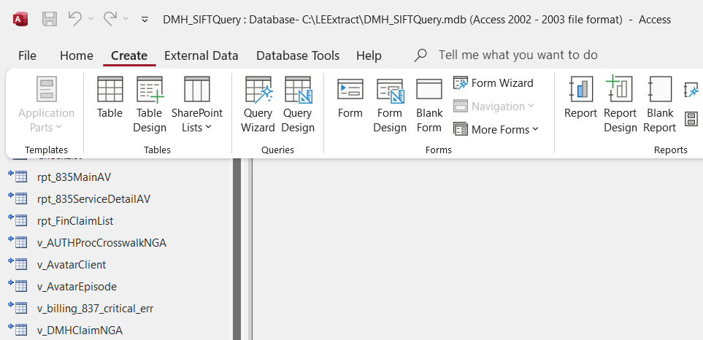
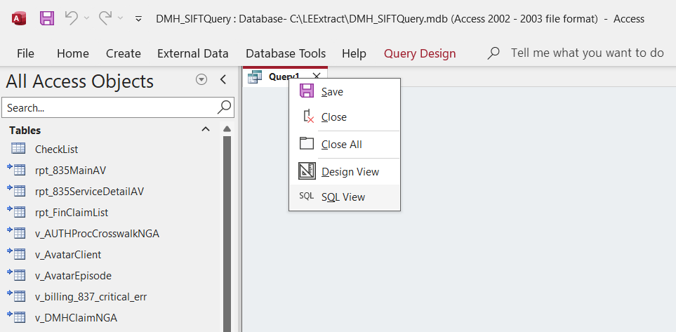
Adding a Query with SQL
Step 1 – Select the Create Menu Option then select the Query Design Ribbon Option
Step 3 – Copy the SQL Code provided above and paste the code onto the white worksheet
Note: Replace any code in the worksheet with your copied code. There will be SELECT; text when you start
Step 2 – Right Click on the Query1 Tab and select the SQL View Menu Option
Step4 – Hit the Save icon at the top left portion of the screen and name your Query then click OK

Slide 18
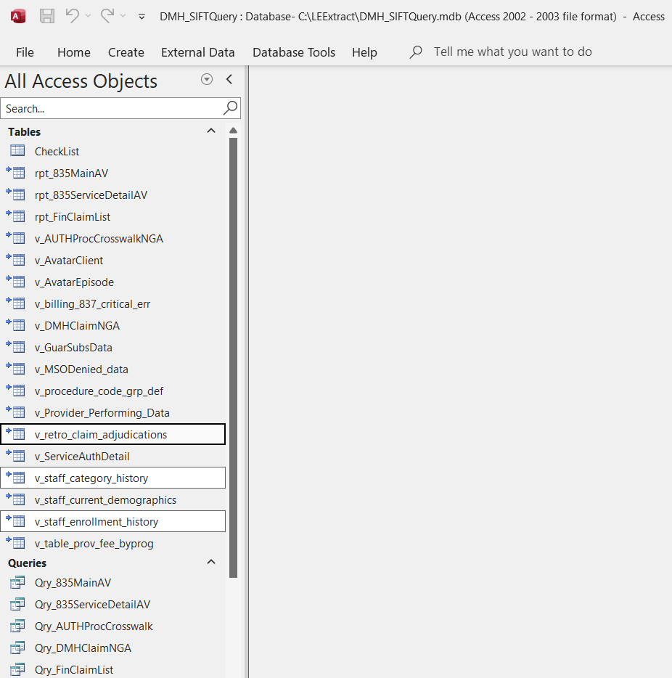
Additional Tables
staff_enrollment_history – This will allow the provider to confirm the existing discipline of a practitioner and its data entry date, this will help them when identifying claims that are denying for invalid discipline for a given procedure code with/without modifiers, given the submit date of the claim and the date the discipline was last updated.
staff_category_history – This will allow the provider to confirm the discipline and practitioner category effective date ranges when a practitioner has multiple disciplines and practitioner categories throughout their practitioner enrollment history.
retro_claim_adjudications – This will allow the provider another method to check their State Denial reasons.

